Slide 1
UPPER SIXTH ARTS
GEOGRAPHY
Field Work 4
Fieldwork in Geomorphology: Rivers and Coasts
Notes:
Good morning, class, and welcome to our geography lesson. I am your geography teacher, Mr Kamdem. Today we are starting Field Work 4: Fieldwork in Geomorphology: Rivers and Coasts.

Slide 2
CLASS INFO
Class, Chapter and Duration
Class | Upper Sixth Arts
Chapter | Module 8: Understanding and carrying out statistical techniques, topographic map analysis, fieldwork and project based learning
Duration | 2 periods (2 × 50 minutes)
Notes:
This lesson is for Upper Sixth Arts. It belongs to Module 8: Understanding and carrying out statistical techniques, topographic map analysis, fieldwork and project based learning. We shall need 2 periods to cover it.

Slide 3
IDENTIFICATION
Lesson Identification
Topic | Fieldwork in Geography
Sub-topic | Field investigations in physical geography
Lesson | Field Work 4: Fieldwork in Geomorphology: Rivers and Coasts
Notions / Concepts | Long profile, clinometer, ranging pole, beach profile, swash, backwash, longshore drift.
Syllabus focus | Long profile of a river and its landforms; coastal processes (waves, longshore drift, erosion, transport); beach materials and coastal landforms.
Competence | Learners are able to survey river and beach profiles and observe landforms and processes.
Notes:
Our topic is Fieldwork in Geography, and the sub-topic is Field investigations in physical geography. The key notions we shall use today are: long profile, clinometer, ranging pole, beach profile, swash, backwash, longshore drift. At the end, you should be able to do this: learners are able to survey river and beach profiles and observe landforms and processes.

Slide 4

HOMEWORK CORRECTION
Correction of the Homework
Question (Field Work 3: Fieldwork in Hydrology: Running Water):
Prepare a recording sheet for width, depth, velocity and pebble size at four sites.
Notes:
Before we start the new lesson, let us correct the homework I gave you at the end of Field Work 3: Fieldwork in Hydrology: Running Water. The question was: Prepare a recording sheet for width, depth, velocity and pebble size at four sites. Take out your exercise books.

Slide 5
HOMEWORK CORRECTION
Correction: Possible Answer
A recording sheet has columns for site number, width (m), depths at 5 points (m), mean depth, float time over 10 m (s), velocity (m/s), discharge (m³/s) and mean pebble length (cm) with roundness.
Notes:
Here is a good answer. A recording sheet has columns for site number, width (m), depths at 5 points (m), mean depth, float time over 10 m (s), velocity (m/s), discharge (m³/s) and mean pebble length (cm) with roundness. Compare it with your own answer and correct your work in red.

Slide 6
LESSON PLAN
Lesson Plan
Correction of the homework
Objectives and recall
Real-life situation and action to take
Learning activities
Board summary
Evaluation, remediation and homework
Notes:
Here is the plan of our lesson today. First, we shall correct the homework. Then we shall look at the objectives and recall what you already know. After that, we shall study a situation from real life and the action to take, and do the learning activities. Finally, we shall copy the board summary, do the evaluation and the remediation, and I will give you the homework.

Slide 7
OBJECTIVES
Objectives
By the end of this lesson, you should be able to:
Survey a long or beach profile with simple tools.
Identify erosional and depositional landforms in the field.
Notes:
Take your time to copy this part; we will continue together.

Slide 8
OBJECTIVES
Objectives (continued)
Measure wave action and longshore drift.
Notes:
By the end of this lesson, you should be able to do three things. Number 1: survey a long or beach profile with simple tools. Number 2: identify erosional and depositional landforms in the field. Number 3: measure wave action and longshore drift.

Slide 9
PREVIOUS KNOWLEDGE
Previous Knowledge
A river has upper, middle and lower courses.
Waves erode and deposit on coasts.
Notes:
Let us first remember what you already know. A river has upper, middle and lower courses. Waves erode and deposit on coasts. Keep this in mind, because we shall build on it today.

Slide 10
REAL-LIFE SITUATION
Situation in Real Life
A class from Limbe visits the coast to study the beach, while a class from Garoua follows the Benue from its tributary to the floodplain. Both must describe landforms and processes.
Notes:
Listen carefully to this situation from real life. A class from Limbe visits the coast to study the beach, while a class from Garoua follows the Benue from its tributary to the floodplain. Both must describe landforms and processes. Think about it, because I am going to ask you some questions.

Slide 11
REAL-LIFE SITUATION
Situation: Question 1
What is the problem in the situation?
Notes:
Question 1: What is the problem in the situation? Think for a moment, then raise your hand to answer.

Slide 12
REAL-LIFE SITUATION
Answer
The classes must study landforms and processes in the field.
Notes:
Good. The classes must study landforms and processes in the field.

Slide 13
REAL-LIFE SITUATION
Situation: Question 2
What tool measures slope angles?
Notes:
Question 2: What tool measures slope angles? Think for a moment, then raise your hand to answer.

Slide 14
REAL-LIFE SITUATION
Answer
A clinometer.
Notes:
Good. A clinometer.

Slide 15
REAL-LIFE SITUATION
Situation: Question 3
What moves sand along a beach?
Notes:
Question 3: What moves sand along a beach? Think for a moment, then raise your hand to answer.

Slide 16
REAL-LIFE SITUATION
Possible Answer
Longshore drift.
Notes:
Good. Longshore drift.

Slide 17
ACTION TO TAKE
Action to Take
Measure landforms in the field to test what we learn in class.
Notes:
From this situation, the action we are working towards in this lesson is the following: measure landforms in the field to test what we learn in class.

Slide 18
JUSTIFICATION
Justification of the Lesson
This fieldwork helps us to see how landforms are shaped.
Notes:
Why is this lesson important for you? This fieldwork helps us to see how landforms are shaped.

Slide 19

1. LONG PROFILE
Activity 1
The long profile of a river.
Notes:
Activity 1. Look carefully at this diagram: the long profile of a river. Observe every detail before I ask the question.

Slide 20
1. LONG PROFILE
Activity 1: Question
How does the gradient change downstream?
Notes:
Here is the question for Activity 1: How does the gradient change downstream? Take one minute to think and write your answer in your rough notebook.

Slide 21
1. LONG PROFILE
Activity 1: Answer
It is steep upstream and becomes gentle downstream.
Notes:
Let us check the answer together. It is steep upstream and becomes gentle downstream.

Slide 22
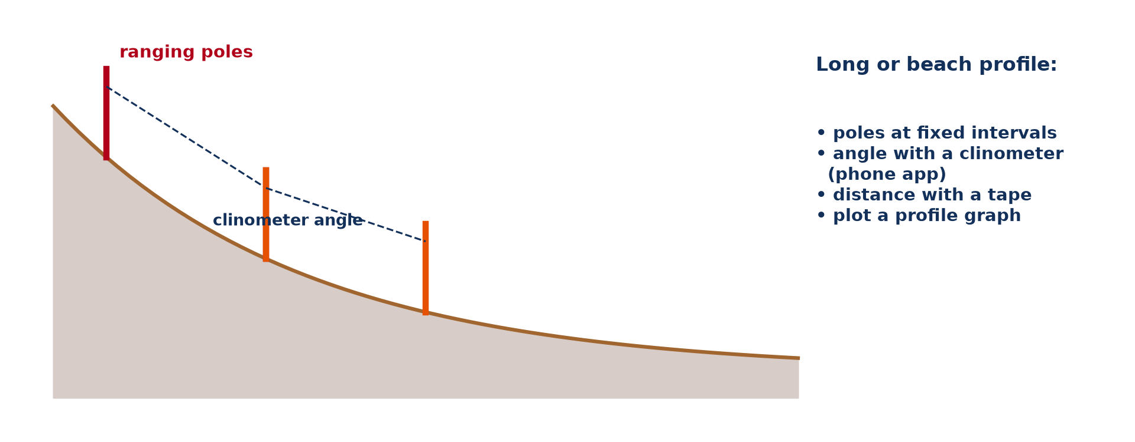
1. SURVEY METHOD
Activity 2
Surveying a profile.
Notes:
Activity 2. Look carefully at this diagram: surveying a profile. Observe every detail before I ask the question.

Slide 23
1. SURVEY METHOD
Activity 2: Question
Which tools are needed to survey a profile?
Notes:
Here is the question for Activity 2: Which tools are needed to survey a profile? Take one minute to think and write your answer in your rough notebook.

Slide 24
1. SURVEY METHOD
Activity 2: Answer
Ranging poles, a clinometer and a measuring tape.
Notes:
Let us check the answer together. Ranging poles, a clinometer and a measuring tape.

Slide 25

2. RIVER LANDFORMS
Activity 3
A meander.
Notes:
Activity 3. Look carefully at this picture: a meander. Observe every detail before I ask the question.

Slide 26
2. RIVER LANDFORMS
Activity 3: Question
Name one erosional and one depositional river landform.
Notes:
Here is the question for Activity 3: Name one erosional and one depositional river landform. Take one minute to think and write your answer in your rough notebook.

Slide 27
2. RIVER LANDFORMS
Activity 3: Answer
Erosional: waterfall (or river cliff). Depositional: point bar (or floodplain).
Notes:
Let us check the answer together. Erosional: waterfall (or river cliff). Depositional: point bar (or floodplain).

Slide 28
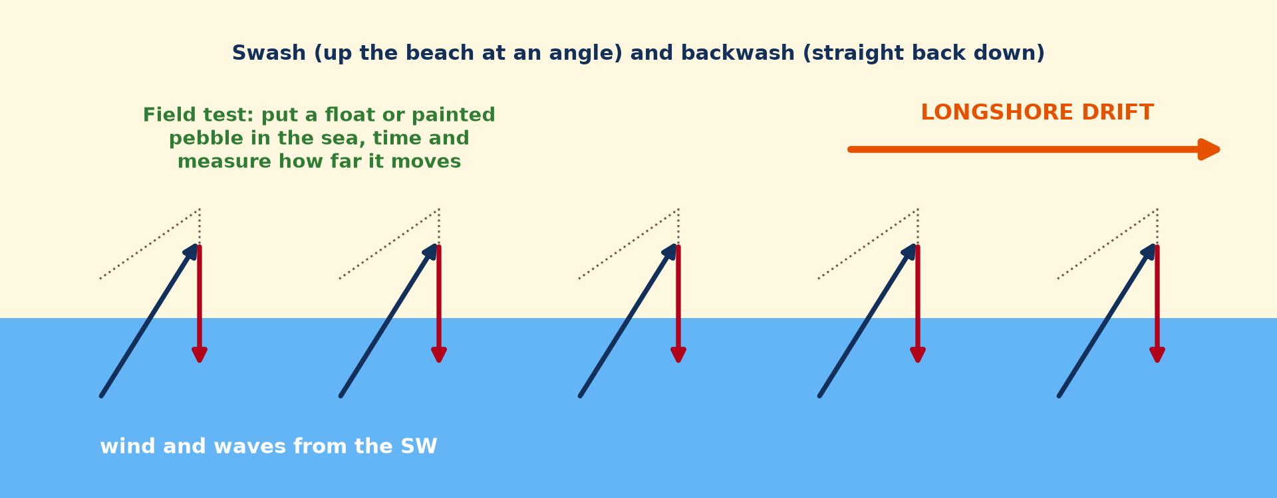
3. COASTAL PROCESSES
Activity 4
Longshore drift.
Notes:
Activity 4. Look carefully at this diagram: longshore drift. Observe every detail before I ask the question.

Slide 29
3. COASTAL PROCESSES
Activity 4: Question
How can longshore drift be measured in the field?
Notes:
Here is the question for Activity 4: How can longshore drift be measured in the field? Take one minute to think and write your answer in your rough notebook.

Slide 30
3. COASTAL PROCESSES
Activity 4: Answer
Put a float or painted pebble in the sea and measure how far it moves in a given time.
Notes:
Let us check the answer together. Put a float or painted pebble in the sea and measure how far it moves in a given time.

Slide 31

3. BEACH MATERIALS
Activity 5
Waves on a beach.
Notes:
Activity 5. Look carefully at this picture: waves on a beach. Observe every detail before I ask the question.

Slide 32
3. BEACH MATERIALS
Activity 5: Question
How does beach material change up the beach?
Notes:
Here is the question for Activity 5: How does beach material change up the beach? Take one minute to think and write your answer in your rough notebook.

Slide 33
3. BEACH MATERIALS
Activity 5: Answer
Larger pebbles are often at the back of the beach (thrown by storm waves); finer sand is near the water.
Notes:
Let us check the answer together. Larger pebbles are often at the back of the beach (thrown by storm waves); finer sand is near the water.

Slide 34
BOARD SUMMARY
Board Summary
Topic: Fieldwork in Geography
Sub-topic: Field investigations in physical geography
Field Work 4: Fieldwork in Geomorphology: Rivers and Coasts
Notes:
Now we are going to copy the board summary. Write the title and the headings neatly in your notebooks. I will give you enough time for each slide, so do not rush.

Slide 35
BOARD SUMMARY
1. The Long Profile of a River
The long profile is studied as follows:
Long profile: It is the gradient of a river from source to mouth. It is steep upstream and becomes gentle downstream.
Notes:
Let us copy The Long Profile of a River. The long profile is studied as follows. On this slide we have Long profile. Write each point on a new line, with the key term first, and explain it in your own words when we revise. When you finish, we go to the next slide.

Slide 36
BOARD SUMMARY
1. The Long Profile of a River (continued)
Survey method: Two ranging poles are placed a fixed distance apart and the angle is measured with a clinometer. The readings are plotted to draw the profile.
River landforms: Waterfalls, rapids and river cliffs show erosion. Point bars and floodplains show deposition.
Notes:
We continue with The Long Profile of a River. On this slide we have Survey method and River landforms. Write each point on a new line, with the key term first, and explain it in your own words when we revise.

Slide 37
BOARD SUMMARY
1. The Long Profile of a River
Illustration: surveying a profile
Notes:
Now draw this illustration in your notebook: surveying a profile. Give it a title and label it clearly.

Slide 38
BOARD SUMMARY
2. Coastal Processes
Coastal processes are studied as follows:
Waves: Wave height and frequency are counted for one minute. Constructive waves build beaches and destructive waves erode them.
Notes:
Let us copy Coastal Processes. Coastal processes are studied as follows. On this slide we have Waves. Write each point on a new line, with the key term first, and explain it in your own words when we revise. When you finish, we go to the next slide.

Slide 39
BOARD SUMMARY
2. Coastal Processes (continued)
Longshore drift: A float or painted pebble is placed in the sea and timed over a distance. Its movement shows the direction and speed of drift.
Notes:
We continue with Coastal Processes. On this slide we have Longshore drift. Write each point on a new line, with the key term first, and explain it in your own words when we revise.

Slide 40
BOARD SUMMARY
2. Coastal Processes
Illustration: longshore drift
Notes:
Now draw this illustration in your notebook: longshore drift. Give it a title and label it clearly.

Slide 41
BOARD SUMMARY
3. Beach Materials and Coastal Landforms
Beach materials and landforms are studied as follows:
Beach materials: Samples are taken along a transect from the sea to the back of the beach. Size and roundness are measured at each point.
Notes:
Let us copy Beach Materials and Coastal Landforms. Beach materials and landforms are studied as follows. On this slide we have Beach materials. Write each point on a new line, with the key term first, and explain it in your own words when we revise. When you finish, we go to the next slide.

Slide 42
BOARD SUMMARY
3. Beach Materials and Coastal Landforms (continued)
Coastal landforms: Cliffs, beaches and spits are sketched, measured and photographed. They are explained by the processes observed.
Notes:
We continue with Beach Materials and Coastal Landforms. On this slide we have Coastal landforms. Write each point on a new line, with the key term first, and explain it in your own words when we revise.

Slide 43
FORMATIVE EVALUATION
Evaluation 1
Give three tools for a beach profile survey.
Notes:
Now let us check what you have understood. Question 1: Give three tools for a beach profile survey. Answer in your exercise book.

Slide 44
FORMATIVE EVALUATION
Expected Answer
Ranging poles, clinometer, tape.
Notes:
The expected answer is: ranging poles, clinometer, tape. If you got it right, well done.

Slide 45
FORMATIVE EVALUATION
Evaluation 2
Describe how to measure longshore drift.
Notes:
Now let us check what you have understood. Question 2: Describe how to measure longshore drift. Answer in your exercise book.

Slide 46
FORMATIVE EVALUATION
Expected Answer
Time a float over a measured distance along the beach.
Notes:
The expected answer is: time a float over a measured distance along the beach. If you got it right, well done.

Slide 47
REMEDIATION
Remediation
Fill in the blanks:
Slope angles are measured with a ______.
Water going up the beach is ______.
Movement of sand along the coast is longshore ______.
Notes:
For those who need more practice, fill in the blanks in your exercise book. The answers are: number 1, clinometer; number 2, swash; number 3, drift.

Slide 48
HOMEWORK
Homework
Draw the long profile of a local stream using heights from a map.
Notes:
For your homework: Draw the long profile of a local stream using heights from a map. We shall correct it at the beginning of our next lesson.

Slide 49
NEXT LESSON
Next Lesson
Our next lesson will be on:
Field Work 5: Fieldwork in Biogeography: Soils and Vegetation
Notes:
Our next lesson will be on Field Work 5: Fieldwork in Biogeography: Soils and Vegetation. Thank you for your attention, and see you next time.

Slide 50
BILINGUAL GAME
Bilingual Game (Jeu Bilingue)
English | Français
Profile | Le profil
Slope | La pente
Beach | La plage
Wave | La vague
Drift | La dérive
Tide | La marée
Notes:
Let us play the bilingual game. I say a word in English, and you give me the French word. Then we do the reverse.

Slide 51
LOGBOOK
Official Logbook (1/2)
Module / Topic | Fieldwork in Geography
Lesson Title | Field Work 4: Fieldwork in Geomorphology: Rivers and Coasts
Expected Learning Outcomes | Survey a long or beach profile with simple tools. Identify erosional and depositional landforms in the field. Measure wave action and longshore drift.
Competence | Learners are able to survey river and beach profiles and observe landforms and processes.
Notes:
I record this information in the official logbook of the class after the lesson.

Slide 52
LOGBOOK
Official Logbook (2/2)
Matter Taught | The Long Profile of a River; Coastal Processes; Beach Materials and Coastal Landforms.
Evaluation | Formative evaluation and remediation exercise.
Homework | Draw the long profile of a local stream using heights from a map.
Enrolment / Present / Absent | ____ / ____ / ____
Achievement | To be completed after the lesson.
Notes:
I complete the second page of the logbook: the matter taught, the evaluation, the homework and the attendance.

Slide 53
TEACHER'S NOTE
Teacher's Note
Timing: Homework correction, plan, objectives 8 min | Recall, situation, action 10 min | 5 activities 30 min | Board summary (copying) 30 min | Evaluation, remediation 10 min | Homework, next lesson 5 min | Logbook 7 min
Without the projector (Activity 1): describe the profile.
Without the projector (Activity 2): list the tools.
Without the projector (Activity 3): identify landforms.
Without the projector (Activity 4): plan the test.
Without the projector (Activity 5): sample the beach.
Notes:
This slide is for me, the teacher: it gives the timing of the lesson and what to do if the projector is not available.

Slide 54
REFERENCES
References
National Geography Syllabus, MINESEC/IGE/IP-SS, 2019 — Module 8 (Practical Geography).
Photo, Activity 3: “Ox-bow” by colinjackson1972, CC BY-NC 2.0, via Flickr (https://www.flickr.com/photos/8253719@N04/2329293239)
Photo, Activity 5: “Carpinteria Bluffs, California (5)” by Ken Lund, CC BY-SA 2.0, via Flickr (https://www.flickr.com/photos/75683070@N00/4063056130)
Diagrams and animations: drawn for this lesson (Geography Department).
Notes:
These are the references and picture credits used to prepare this lesson.

